Slide 1
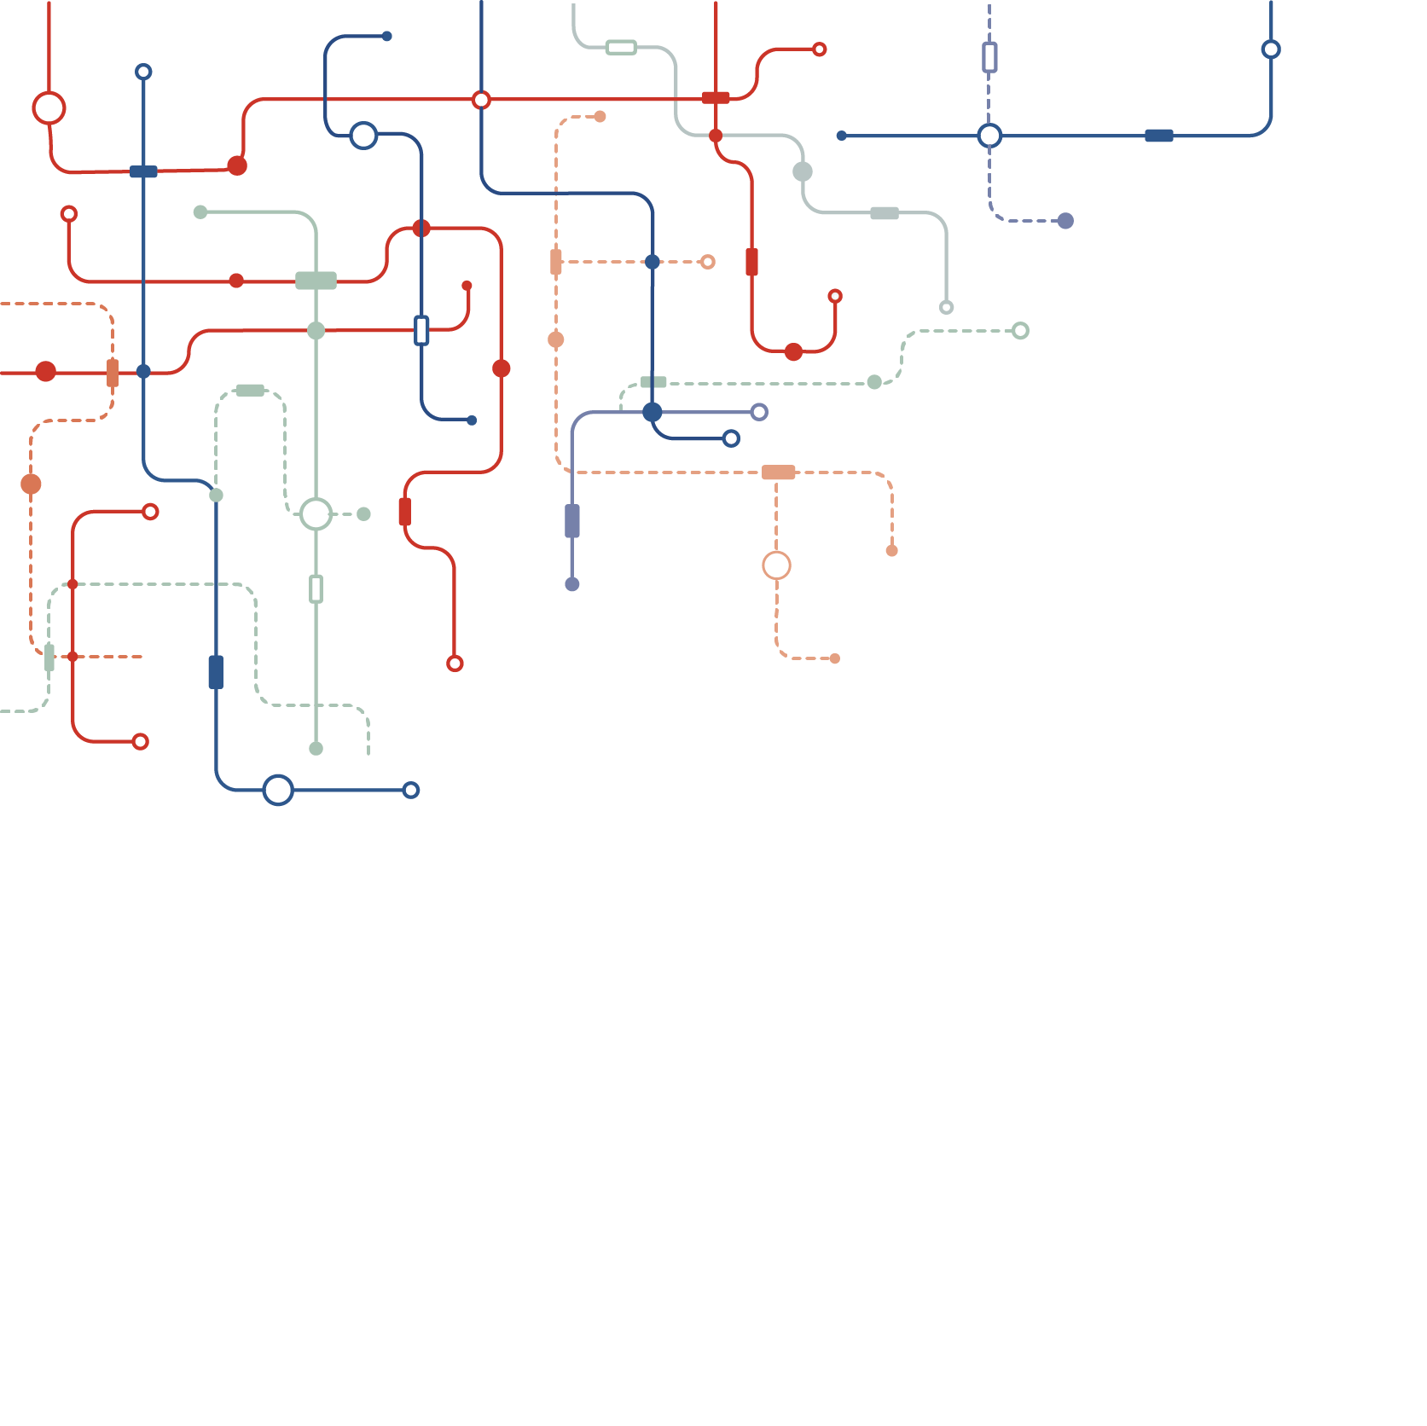

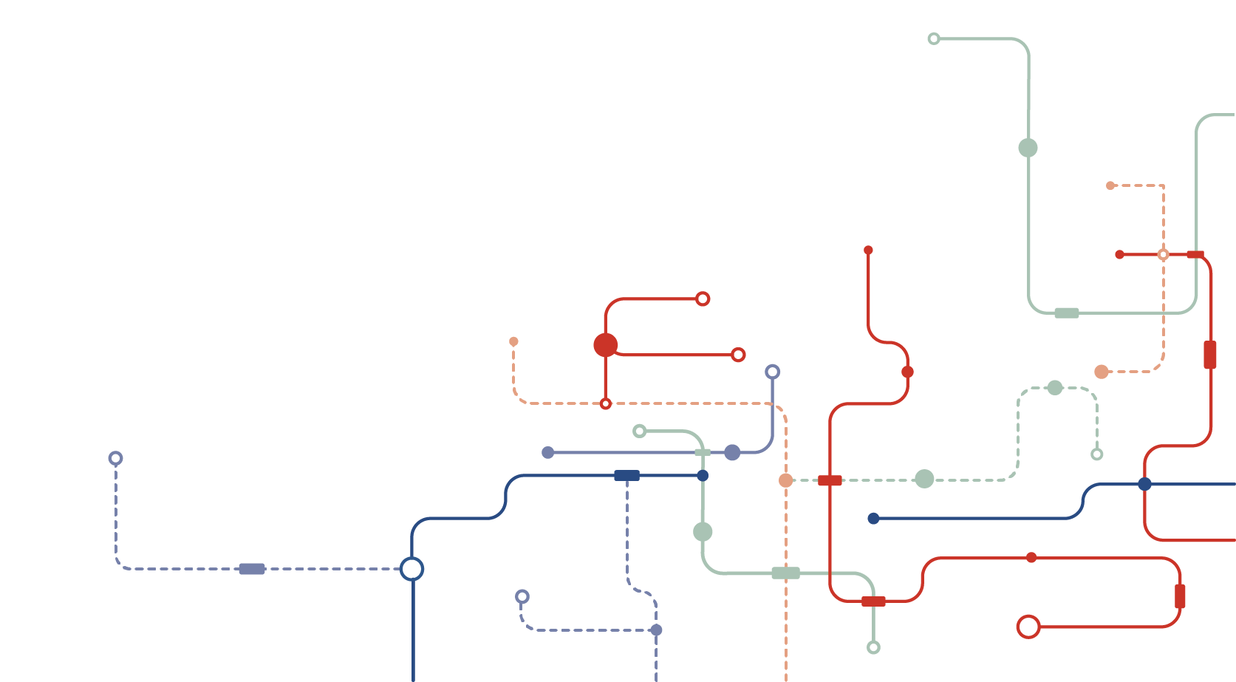

2021
Maricopa County – Risk Management
Safety submit
Data Analyst
Zixiang Michael Jin

Slide 2

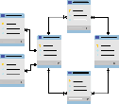
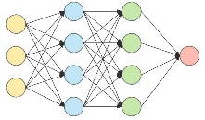
01
Data Engineer
02
who build data pipelines to stream data across platforms so that data from different department are comparable to each other.
03
Data Analyst
Based on the data infrastructure created by engineer, data analyst then design database, reporting system, and define KPI
Data Scientist
Apply cutting-edge modeling for predicting, such as regression, Decision-Tree and Neuro network.

Slide 3
Index
01
Osha KPIs
02
Data Project
03
Predictive Modeling
04
Example: Covid-19 Command Center

Slide 4
Part 01
Osha KPIs
OSHA Key Performance Indicator is used to measure how many incidents have occurred, or how severe they were.
OSHA has established specific mathematic calculations that enable any company to not only monitor their own performance, but they are comparable across any department, division or group.

Slide 5




Osha KPI
Incident Rate
Severity Rate
Lost Workday Rate
SEVERITY RATE – a mathematical calculation that describes the number of lost days experienced as compared to the number of incidents experienced.
The is calculated by multiplying the number of recordable cases by 200,000, and then dividing that number by the number of labor hours at the company.
a mathematical calculation that describes the number of lost workdays per 100 full-time employees in any given time frame.

Slide 6
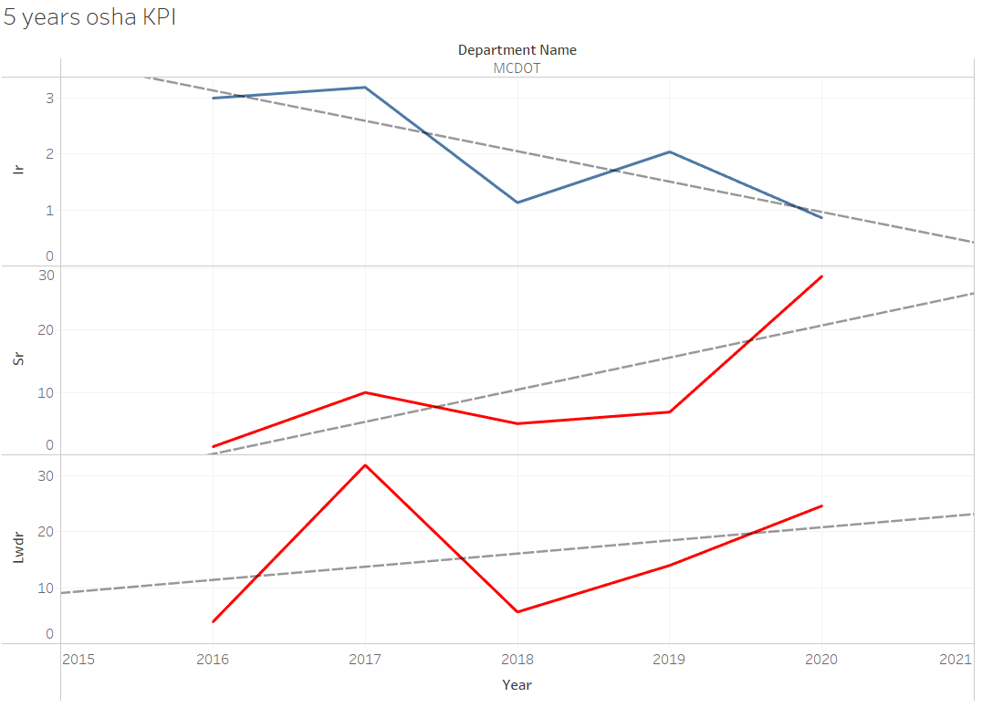
Osha KPI

Slide 7
Osha KPI
OSHA KPI
KPI
Osha KPIs have been standardized, so that managers can compare statistically significant KPIs with other department or with their own past safety performance. Osha KPIs will help managers to determine where his department may need additional program assistance in order to prevent accidents from happening again.
Accident
Strategy

Slide 8
Part 02
Data Project
Data Collection, Database Design, and Reporting system

Slide 9
Data Project
Database Design
Predicting
Modeling
Problem
Statement
Reporting
System

Slide 10


Problem Statement
With a good problem statement, teams:
Align their efforts toward a common goal
Define what that goal is
Care about meeting the goal
Problem statements fall apart when they’re too vague or too prescriptive. Ultimately, you and your team need to judge whether a problem statement is working for you. Does it help your team recognize what their focus is? Does it keep you aligned in the same direction?

Slide 11
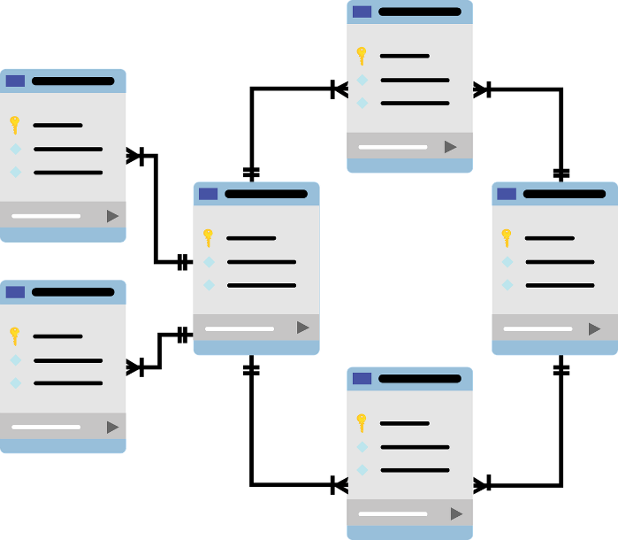
Database Design

Slide 12
Reporting System
Increase Accuracy and consistancy
02
Increase Latency
01
04
Reduce Human Error
03
Easy Access to anyone

Slide 13
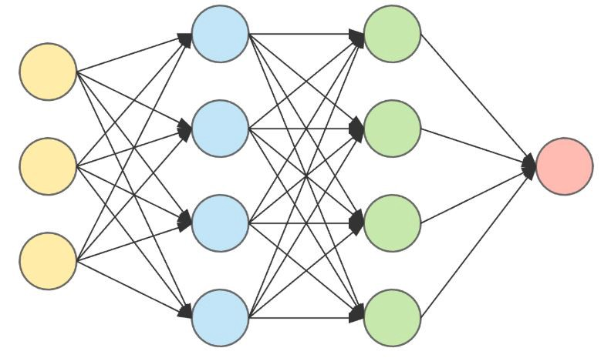
Predicting Modeling

Slide 14
Part 03
Covid-19 Command Center

Slide 15
Part 04
Data Project for you

Slide 16
2021
Maricopa County – Risk Management
Thanks
Zixiang Michael Jin 2/22/2021

